Slide 1
Sales Strategy Analysis
for New Product Launch

Slide 2
Business Goals
As the way in which consumers buy products is changing, our sales tactics have to change too. To achieve this goal, the sales team want to identify the most effective sales techniques for product launches.
The team wants to know the following insights:
Difference in performance of Email, Call and Email+Call sales strategies.
Determining the best sales strategy for new product launch.

Slide 3
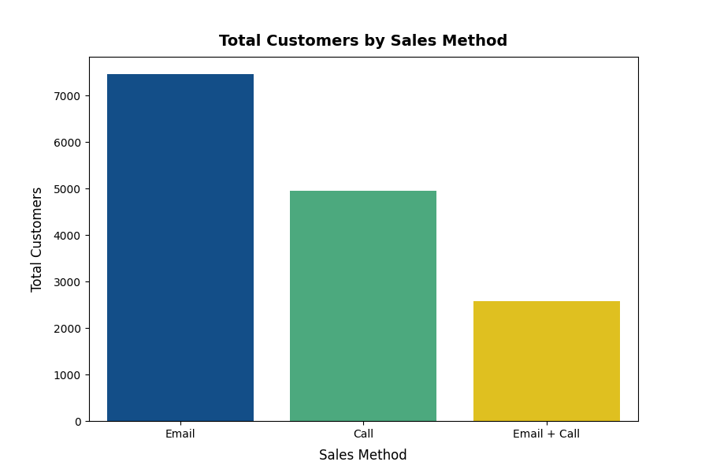
Outcomes
Difference in the number of customers approached by each sales method
From the last 6 weeks of data, approximately half of the customers were targeted through Email, followed by Call-only approach, which was used to target 33% customers.
The combined Email+Call approach acquired 17% customers.

Slide 4
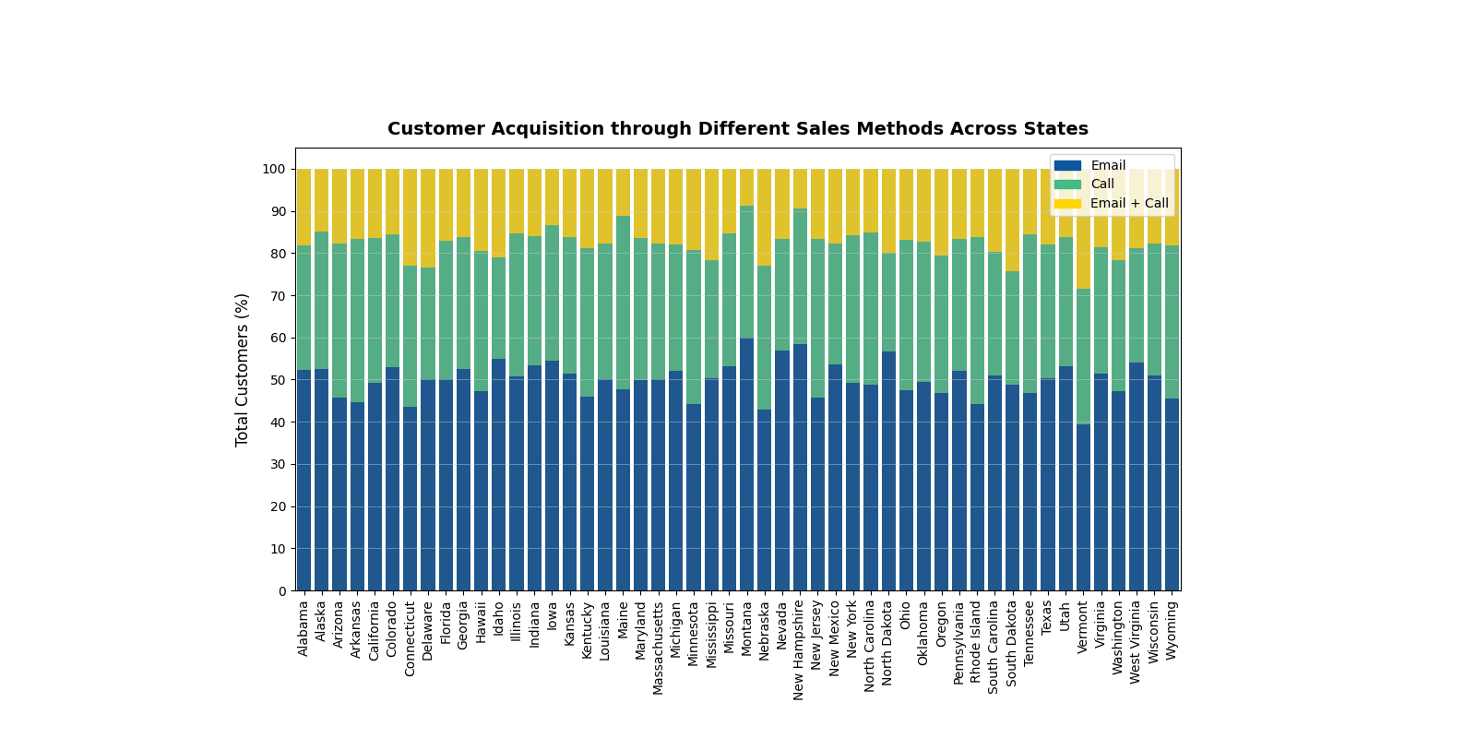
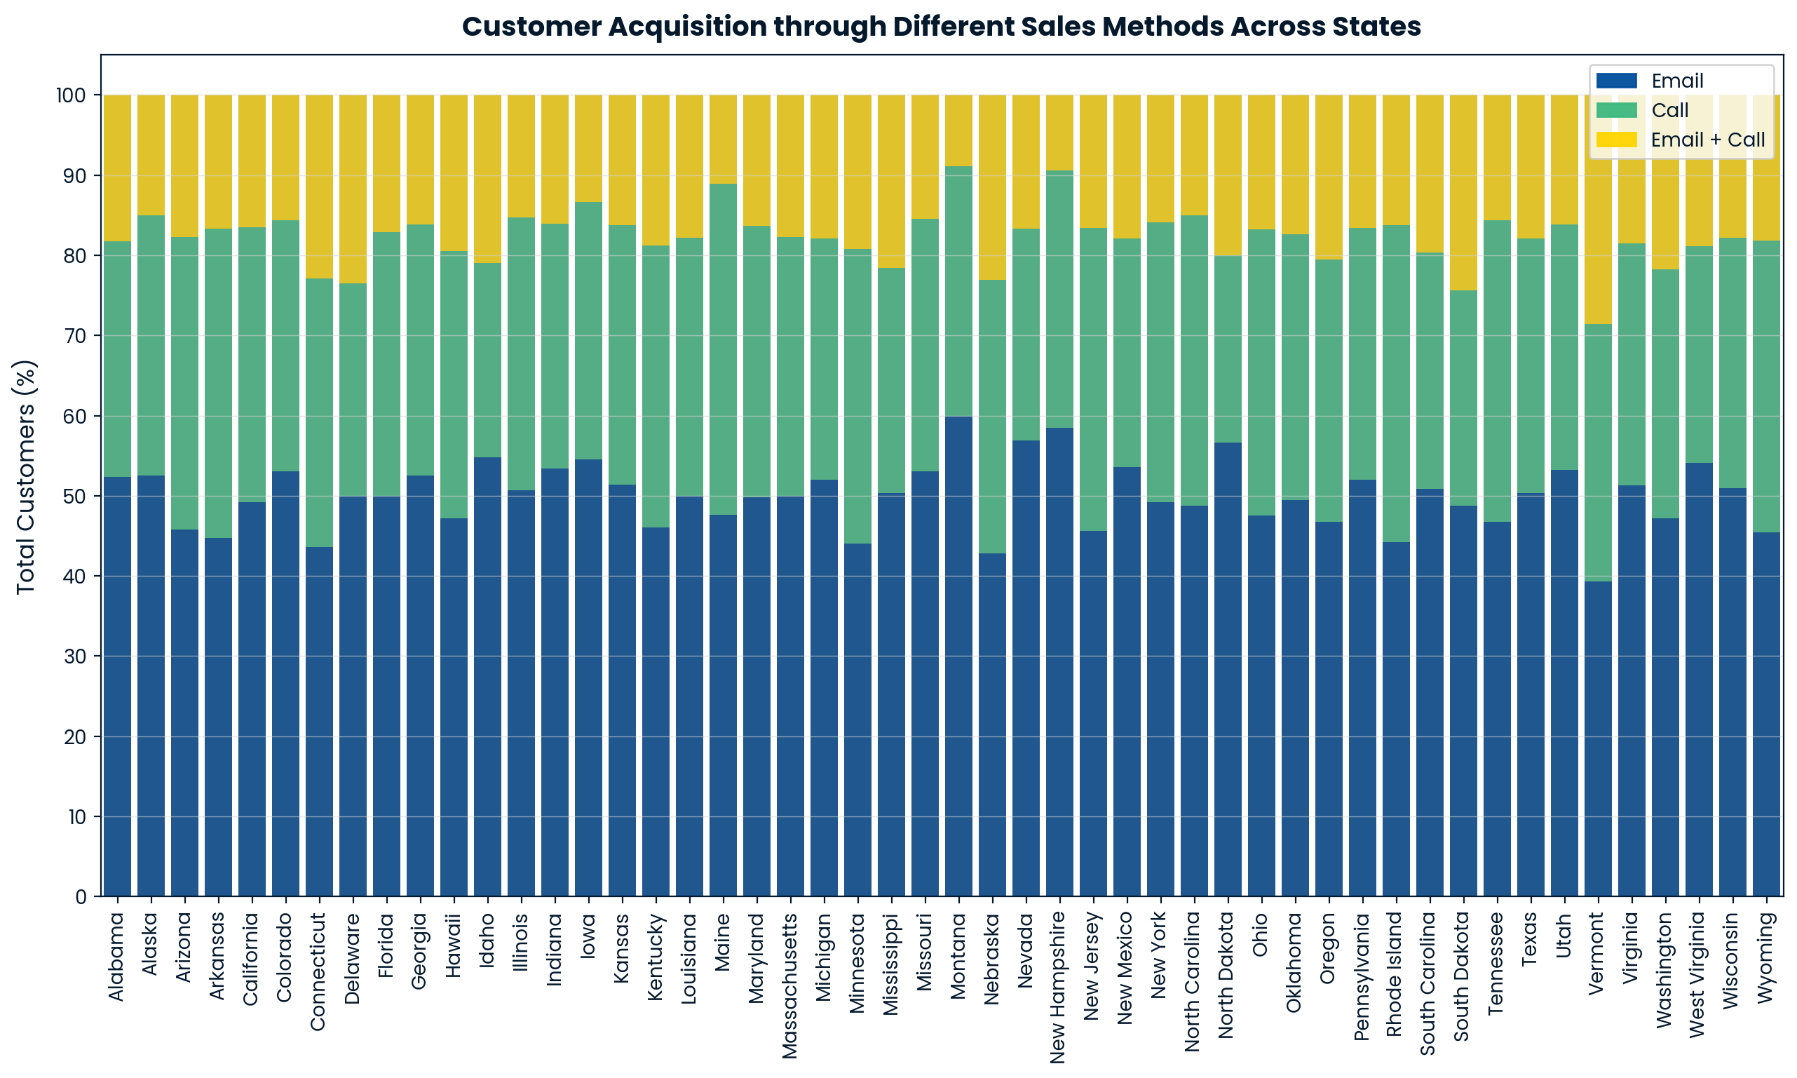
Outcomes
Difference in the number of customers approached by each sales method across states
Email is the most common method of customer acquisition across all states, acquiring 40-60% customers in each state.

Slide 5
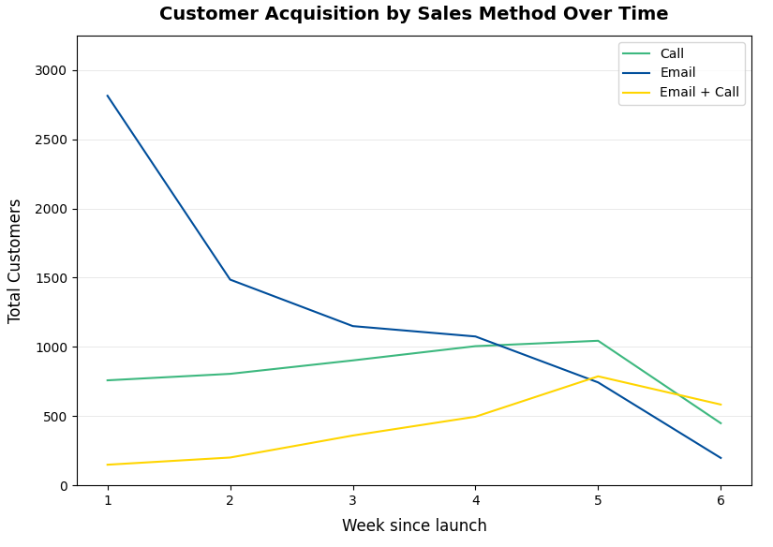
Outcomes
Difference in the number of customers approached by each sales method over time
If we look at the number of customers targeted by each sales method over time, Email had highest share in the initial period. But it declines dramatically over time.
Call-only and Email+Call methods maintain relatively consistent growth.

Slide 6
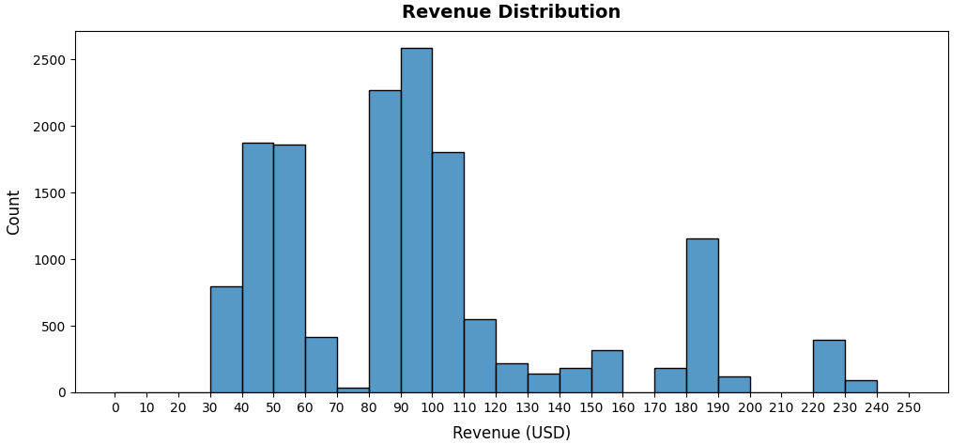
Outcomes
Difference in revenue – Transaction value per sale
Most transactions fall within the $40-60 and $80-110 ranges.
There is also a small, high-value customer segment between $180-190.

Slide 7
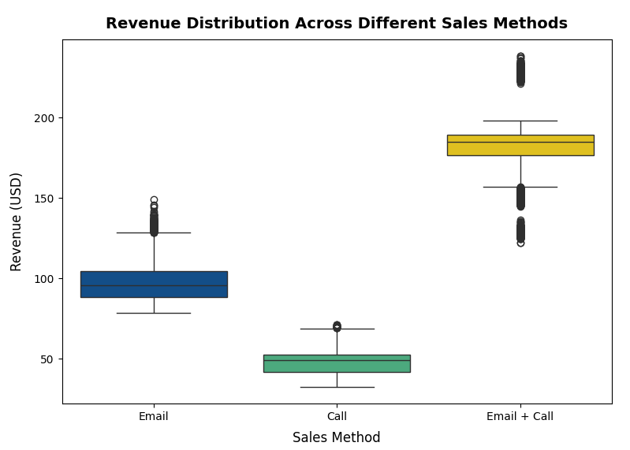
Outcomes
Difference in revenue by sales method – Transaction value per sale
From the boxplots here, we can see that the Email+Call approach has the highest per-transaction revenue (with median at $185), followed by Email-only approach, which has a $95 median.
Call-only method has the lowest per-transaction potential with median of $50.

Slide 8
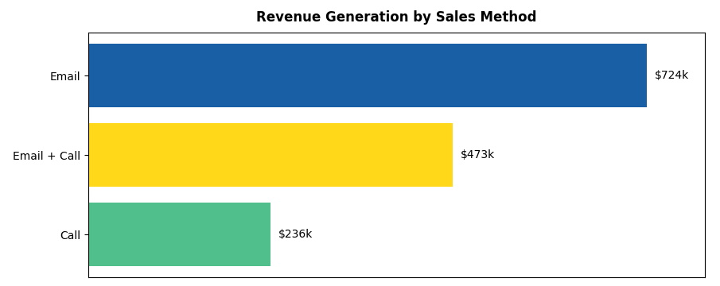
Outcomes
Total revenue share of each sales method
The total revenue was $1.43 million in last 6 weeks. Email-only strategy generated most revenue ($724k), followed by the Email+Call approach, which generated $473k. Call-only approach contributed the least in total revenue.

Slide 9
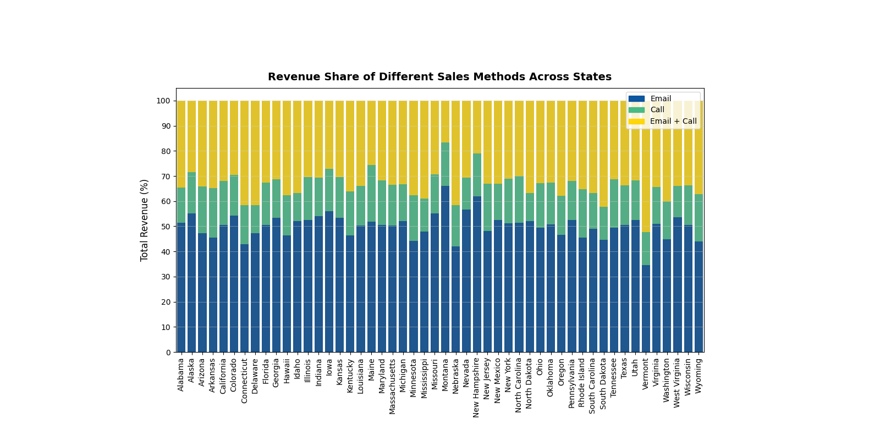
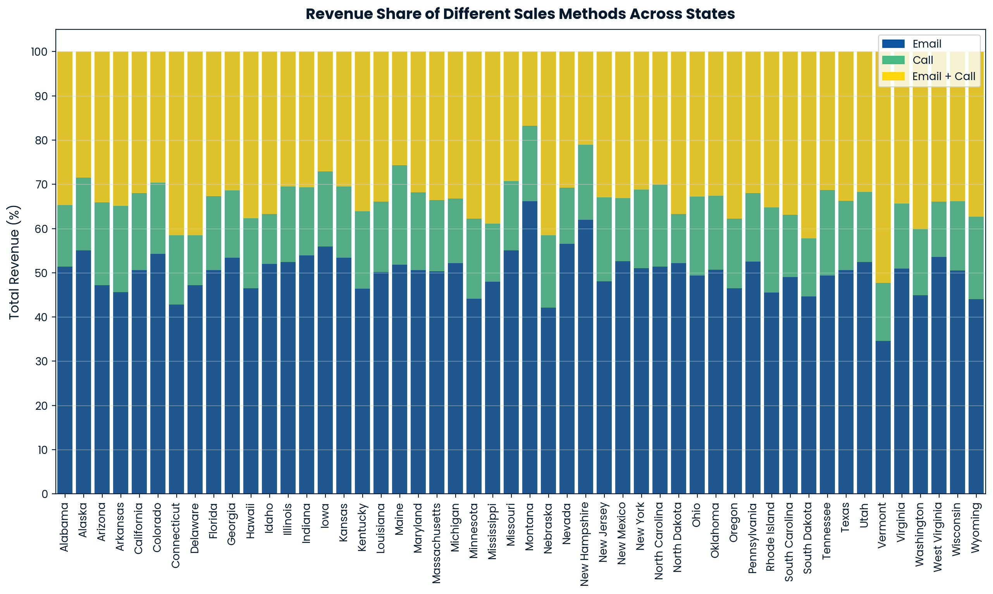
Outcomes
Total revenue share of each sales method across states
Email is most effective across all states (except Vermont), generating between 40-65% revenue.
The Email+Call approach also has higher revenue share.

Slide 10

Outcomes
Change in total revenue of each sales method over time
Initially Email-only strategy had a significant revenue share (~84% in week 1). However, it decreases dramatically over time to just $25k by week 6. On the other hand, Email+Call approach shows a remarkable growth by more than 6x. The Call-only approach too shows a strong upward momentum, increasing to more than double by week 5, before declining in week 6.

Slide 11
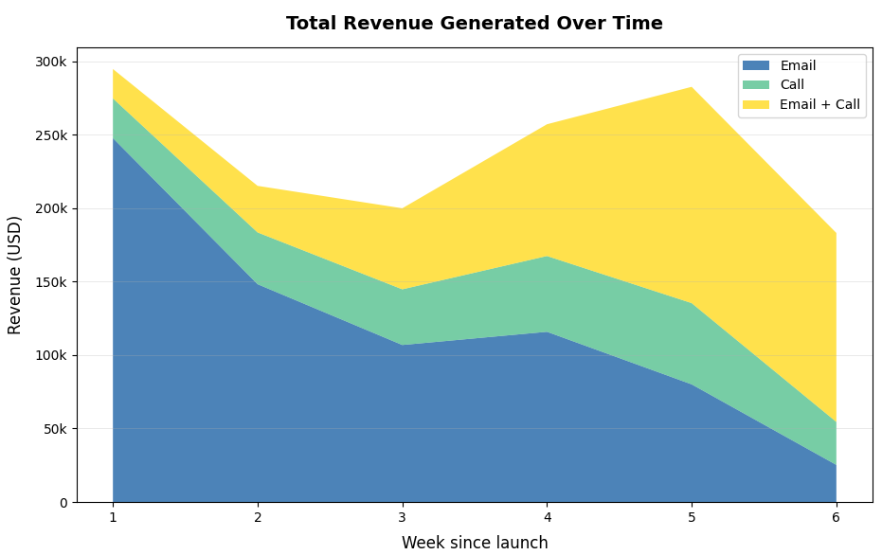
Outcomes
Determining the best sales strategy for new product launch
Email-only approach acquires most customers and also generates most revenue. It is very effective in the initial period.
Email+Call is most effective over time.

Slide 12
Business Metrics
Our goal is to identify the most effective sales techniques for product launches to maximize ROI. Therefore, I would recommend using the percentage of total weekly revenue by sales method as our key performance metric. This will help measure the actual financial impact of each approach.
We should also keep track of the total weekly customer acquisition by sales method to understand the most effective methods for customer acquisition over time.
Based on the last 6 weeks of data:
The weekly revenue generated through the combined Email+Call approach showed strongest growth, increasing from $25k in week 1 to $120k by week 6. It also has the highest revenue per-transaction. Therefore, if this increases further, it indicates a very good sign to maximize our ROI.

Slide 13
Recommendation
For future product launches, I would recommend:
Prioritizing Email-only approach for volume-based strategies in the initial weeks.
Focusing on Email+Call for high-value customer acquisition.
The call-only method may need strategic re-evaluation given its overall limited revenue potential despite acquiring one-third customers.

